Slide 1
The Billiard Problem
William Willmon
Dr. Danielle McDermott
Pacific University Physics Department

Slide 2
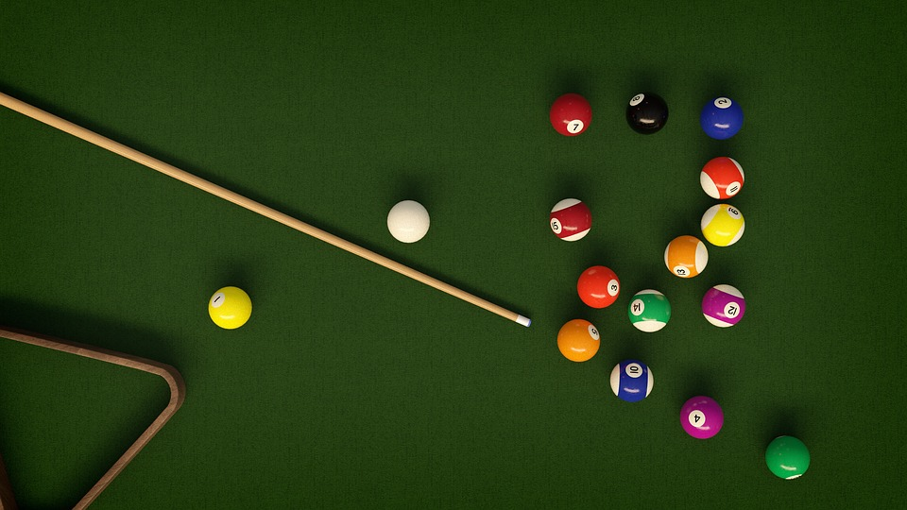
What is Billiards?
Billiards is a table top game with may variations
Different games include snooker, American pool, Carom billiards, etc.
Balls range from 51mm – 68mm

Slide 3
The Billiards Problem
Consider a ball moving on a frictionless, horizontal table with walls at the edges of the table
This problem models the dynamics of this ball on the table
Along with modeling the ball, it allows us to model chaotic behavior that occurs in everyday life

Slide 4
Chaos and Lyapunov Exponent
No formal definition of chaos, the best definition states that:
A dynamical system that must be modeled using nonlinear equations of motion
The Lyapunov exponent is a number used to determine the rate of separation from initial conditions
This value is used to describe the chaos of a system

Slide 5
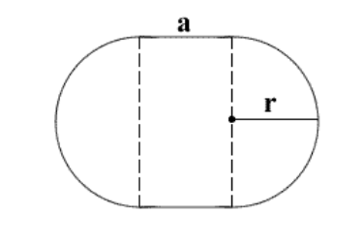
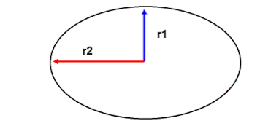
Different Table Shapes
Two different table shapes to study
Stadium table
Elliptical table

Slide 6
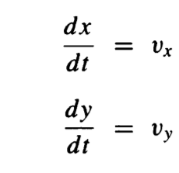
Equations of Motion
Equations of motion
Frictionless table
Given by constant velocity between walls
Velocity is only change by collisions

Slide 7
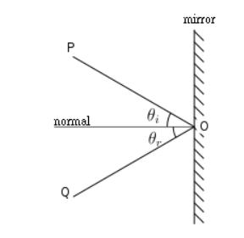

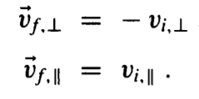
Collisions with Walls
Elastic – Conservation of energy and momentum
Perfect Reflection

Slide 8
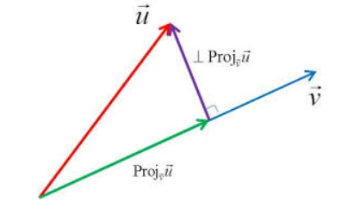
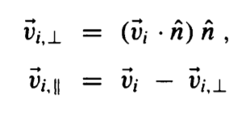
Collisions with Walls
Break the velocity into components
Projection on the normal vector

Slide 9
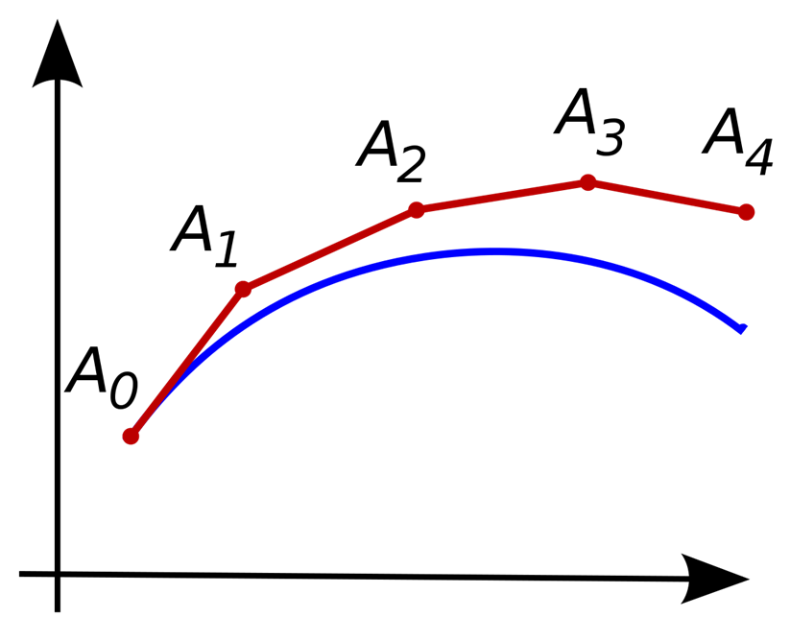
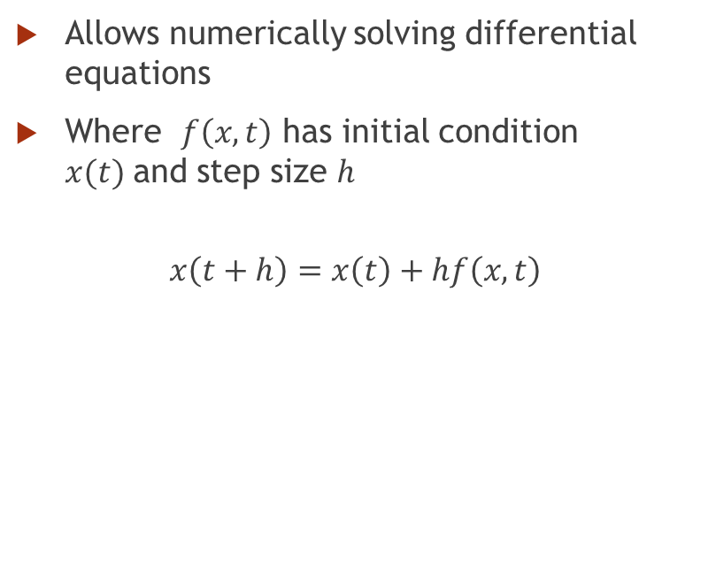
Euler’s Method
Allows numerically solving differential equations
Where $f\left(x,t\right)$ has initial condition $x(t)$and step size $h$
$$x\left(t+h\right)=x\left(t\right)+hf\left(x,t\right)$$

Slide 10


Applying Euler’s Method Between Walls
Use equations of motion as $f\left(x,t\right)$ and $f\left(y,t\right)$
Set initial conditions so $x= 1.2 m, y= 0 m, v=1\frac{m}{s} @ θ= π/4$

Slide 11
Iterating Smaller Timestep
Use Euler’s Method to approach wall
Once ball has passed the wall, make the time step smaller
Reflect the ball off the wall, while removing as much error as possible and still being efficient
Return to normal time step

Slide 12
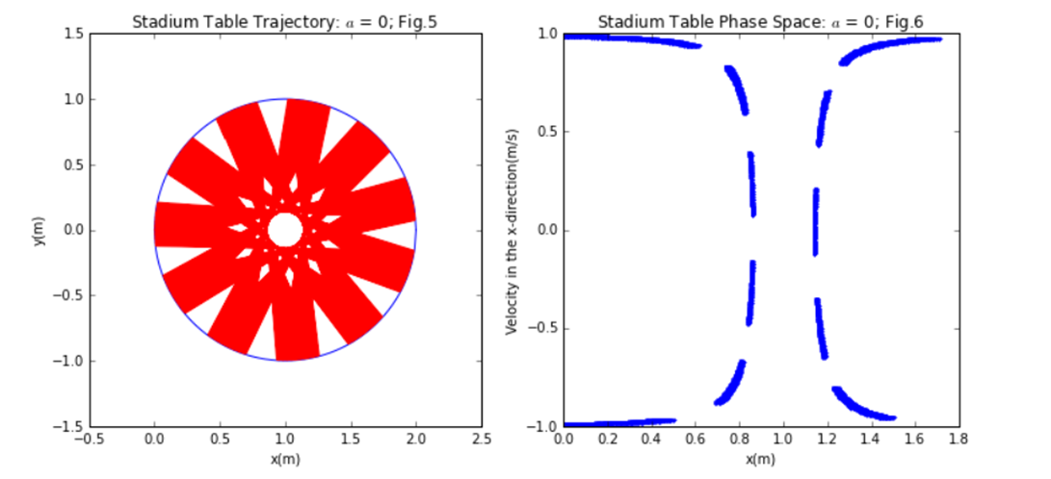
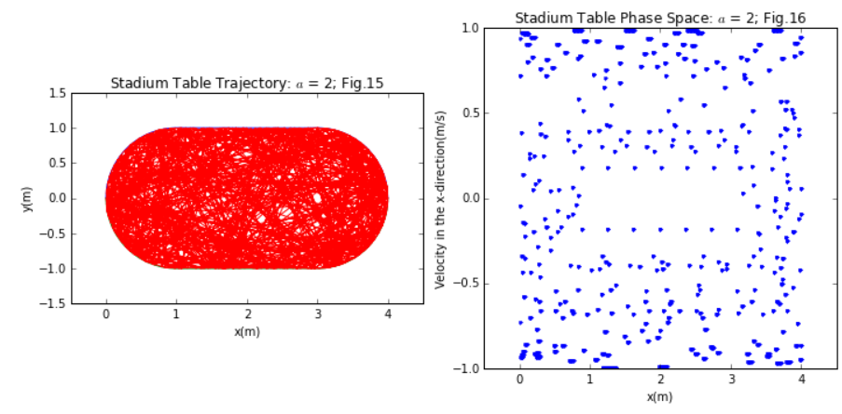
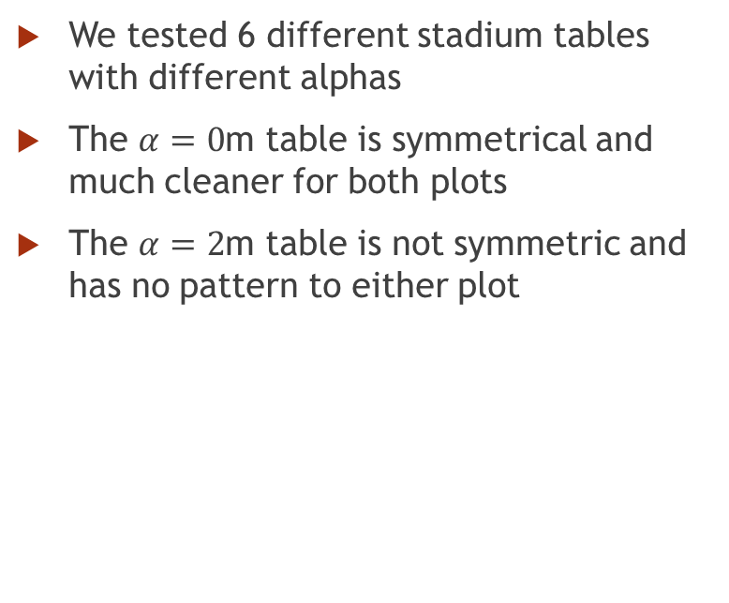
Stadium Table Results
We tested 6 different stadium tables with different alphas
The $α=0$m table is symmetrical and much cleaner for both plots
The $α=2$m table is not symmetric and has no pattern to either plot

Slide 13
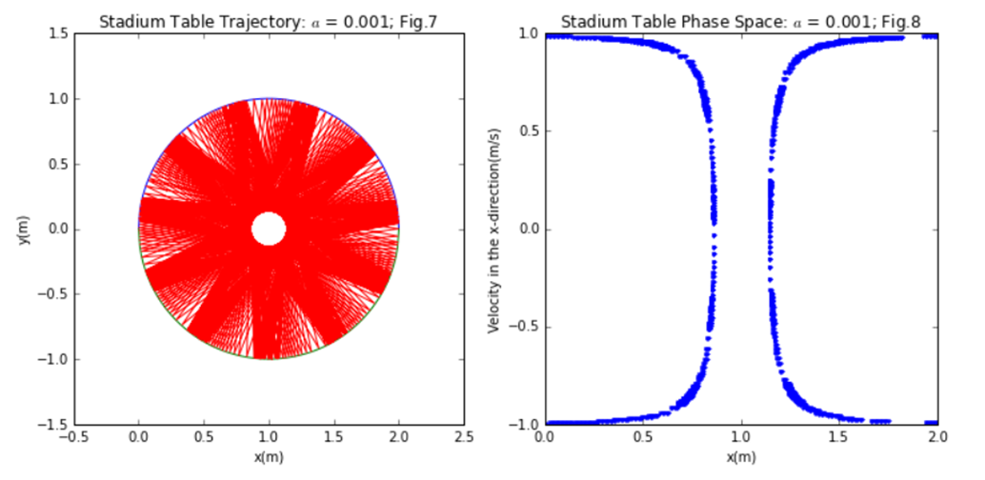
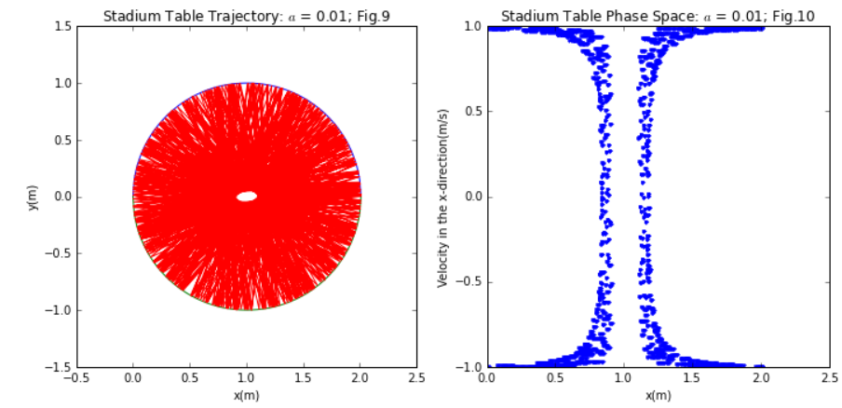
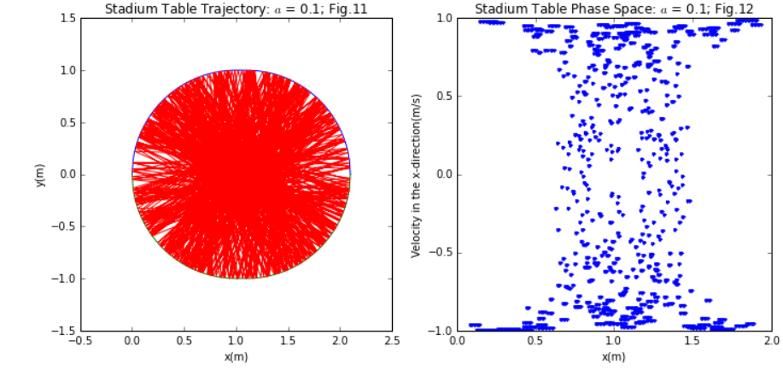
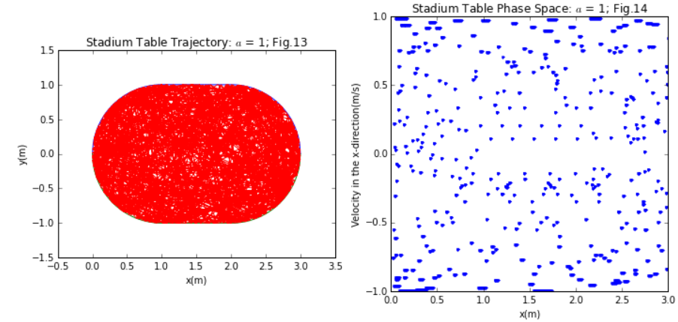
Stadium Table Results

Slide 14
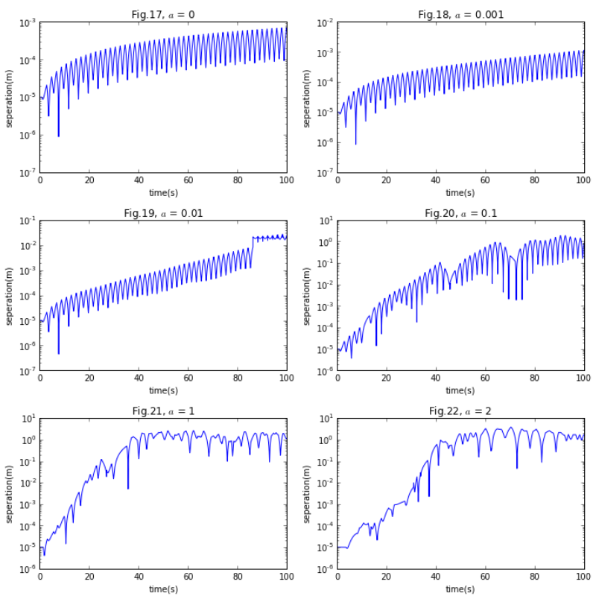
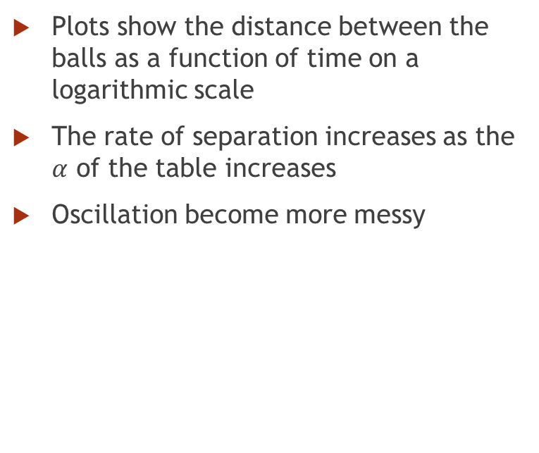
Stadium Table Divergence
Plots show the distance between the balls as a function of time on a logarithmic scale
The rate of separation increases as the $α$ of the table increases
Oscillation become more messy

Slide 15
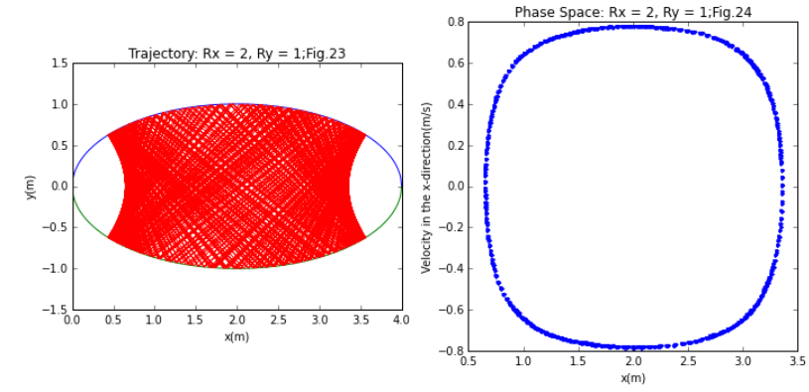
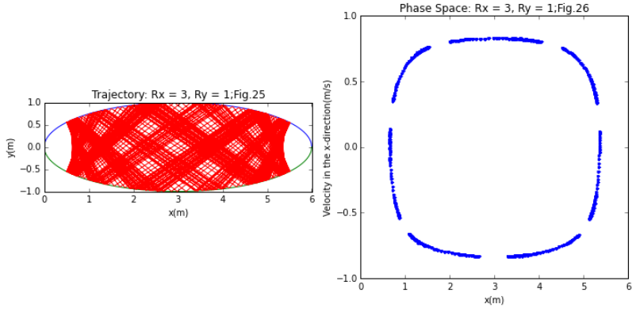

Elliptical Table Results
Similar to that of the Stadium table with $α=0$m
It is important to note voids on either end of the table
Both plots are symmetric

Slide 16
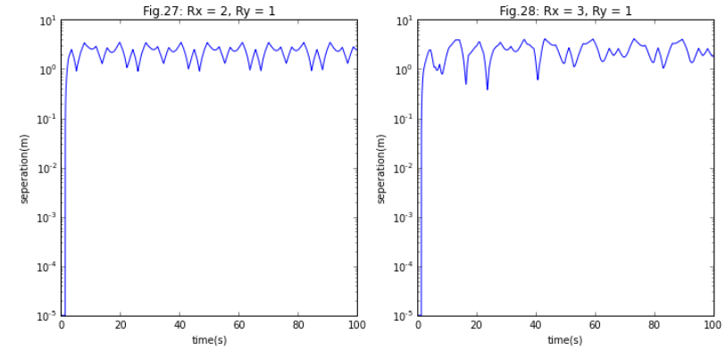
Elliptical Table Divergence
The immediate spike to a separation
Constant oscillations after spike

Slide 17
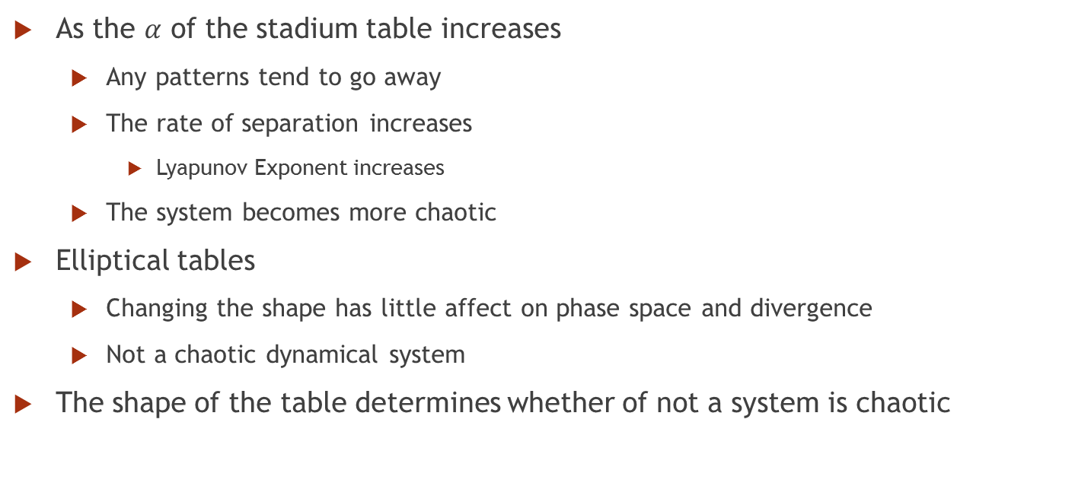
Analysis
As the $α$ of the stadium table increases
Any patterns tend to go away
The rate of separation increases
Lyapunov Exponent increases
The system becomes more chaotic
Elliptical tables
Changing the shape has little affect on phase space and divergence
Not a chaotic dynamical system
The shape of the table determines whether of not a system is chaotic

Slide 18
Summary
In all, the chaos is determined by the shape of the table
Determined through plots that describe and model the dynamics of the system
The more symmetric the table, the less chaotic the system is
Little changes to the symmetric table can result in relevant outcomes

Slide 19

Acknowledgements
Dr. Danielle McDermott
The Computational Physics Class ,2018
Pacific University Physics Department

Slide 20
References
Phase space. Encyclopedia of Mathematics. URL: http://www.encyclopediaofmath.org/index.php?title=Phase_space&oldid=32015
Giordano, Nicholas J., and Hisao Nakanishi. Computational Physics. 1st ed. Dorling Kindersley, 1997.
Bishop, Robert. “Chaos.” Stanford Encyclopedia of Philosophy, Stanford University, 13 Oct. 2015, plato.stanford.edu/entries/chaos/.
“Lyapunov Characteristic Exponent.” From Wolfram MathWorld, mathworld.wolfram.com/LyapunovCharacteristicExponent.html.
CalculatorSoup, LLC. “Stadium Calculator.” CalculatorSoup, www.calculatorsoup.com/calculators/geometry-plane/stadium.php.
“Ellipse? Circle? How Are They Related?” Application of Maths to Swimming, mathsisinteresting.blogspot.com/2008/08/ellipse- circle-how-are-they-related.html.
“JCCC MATH/PHYS 191.” Vector Projection - JCCC MATH/PHYS 191, jccc-mpg.wikidot.com/vector- projection.
“Reflection (Physics).” Wikipedia, Wikimedia Foundation, 9 May 2018, en.wikipedia.org/wiki/Reflection_(physics).

Slide 21
Questions?

